Slide 1

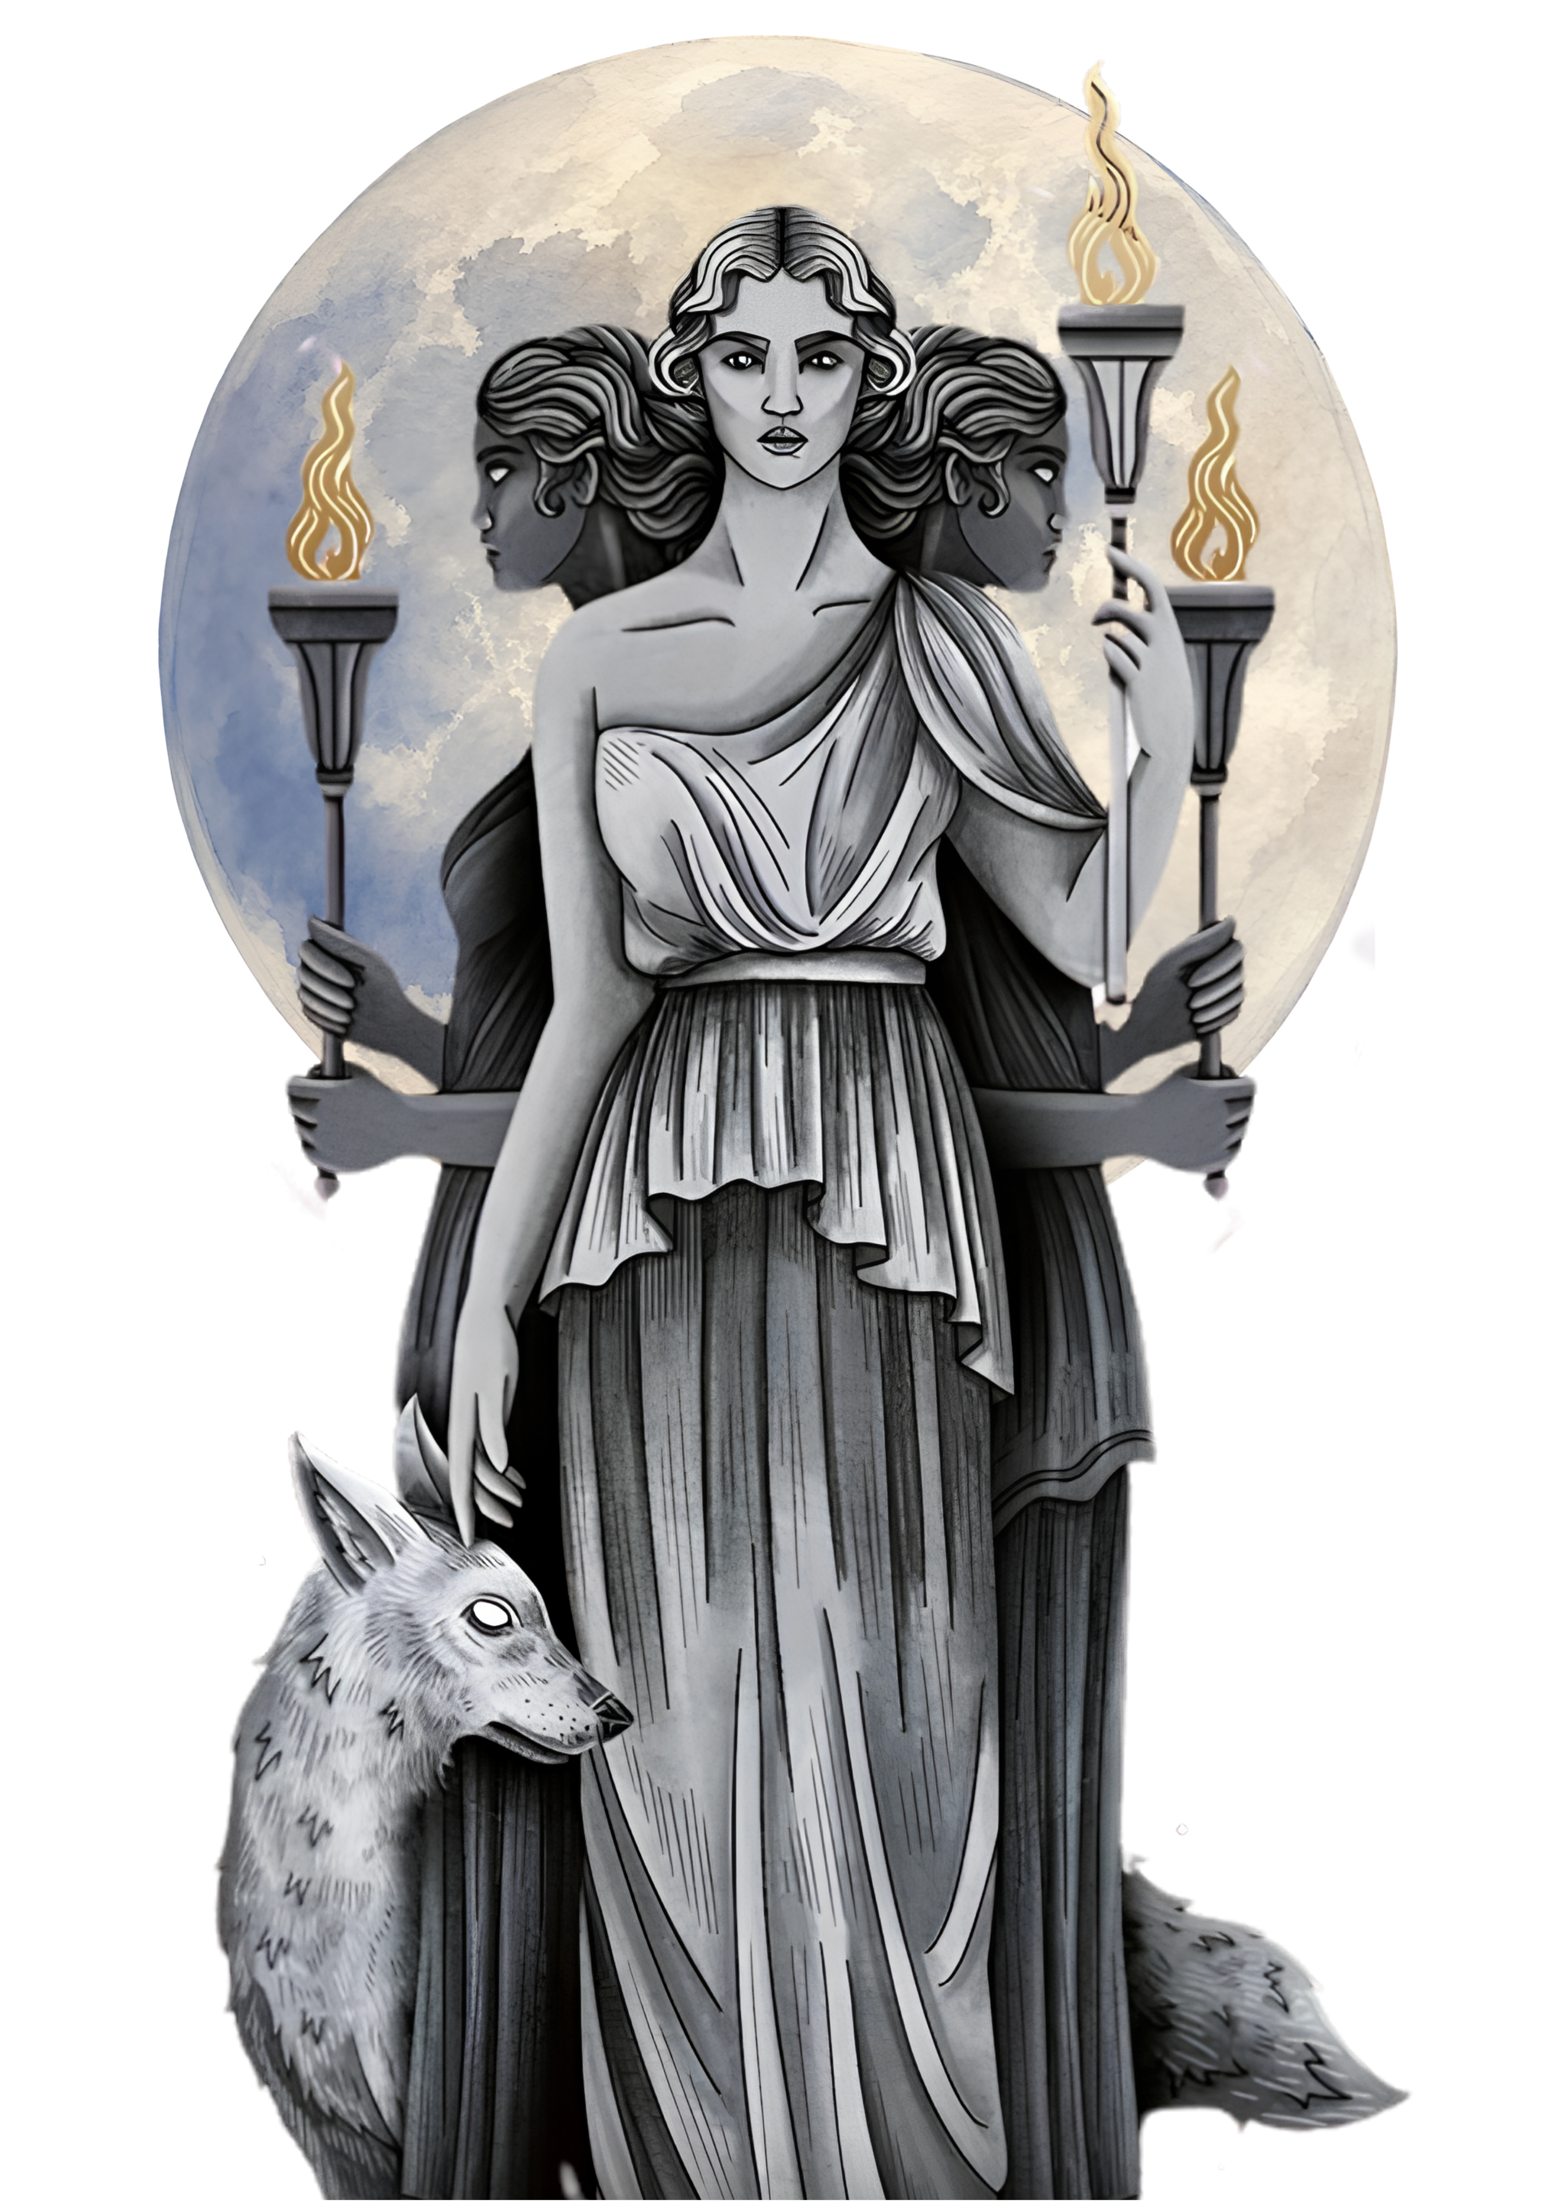
HEKATE
a novel-in-verse by NIKITA GILL
The Greek Goddess of Witchcraft
SSBA Shortlist
Notes:
Aim: build intrigue, give them the mythological background and the world, introduce the verse form, and set up questions to read for.

Slide 2

When we think of witches, we think of the image from 1500-1800.
Usually, it was a way to target women who were clever or who thought for themselves.
What words do you think of when you think of a witch?
HEKATE · NIKITA GILL
2
Notes:
Ask them to come up with some keywords: expecting ugly, evil, magic, potions etc
Then ask them if they can think of a beautiful witch, or a good witch. (examples could be from the Wizard of Oz/ wicked; Hermione Granger; Scarlet Witch (a bit)
Can they think of the powers that witches have

Slide 3
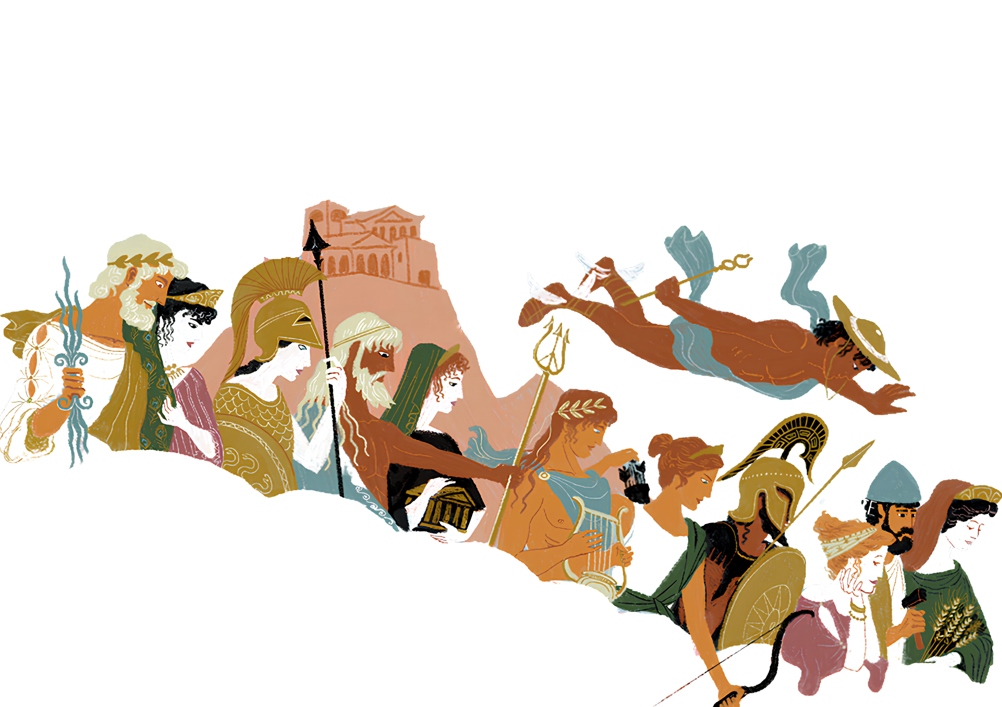
BEFORE WE BEGIN
These are the Olympian gods, the ruling gods and goddesses of ancient Greece. Can you name any?
Ancient Greece: Gods and Goddesses
Hermes
Hekate is a good witch from Ancient Greece, 3000 years ago
And she’s not just any witch….she’s the goddess of witchcraft
The Ancient Greek believed and worshipped many gods and goddesses: not just one.
Zeus
Hera
Hephaestus
Athena
Poseidon
God of War
But where is Hekate?
King of the Gods and storms
Queen of the gods and marriage
The messenger god
God of the seas
God of the forge
Goddess of love
Goddess of the moon and the hunt
Goddess of wisdom and war
Goddess of hearth and home
God of the sun, music, and medicine
Goddess of the harvest
Hestia
Apollo
Artemis
Ares
Demeter
HEKATE · NIKITA GILL
Aphrodite
2

Slide 4
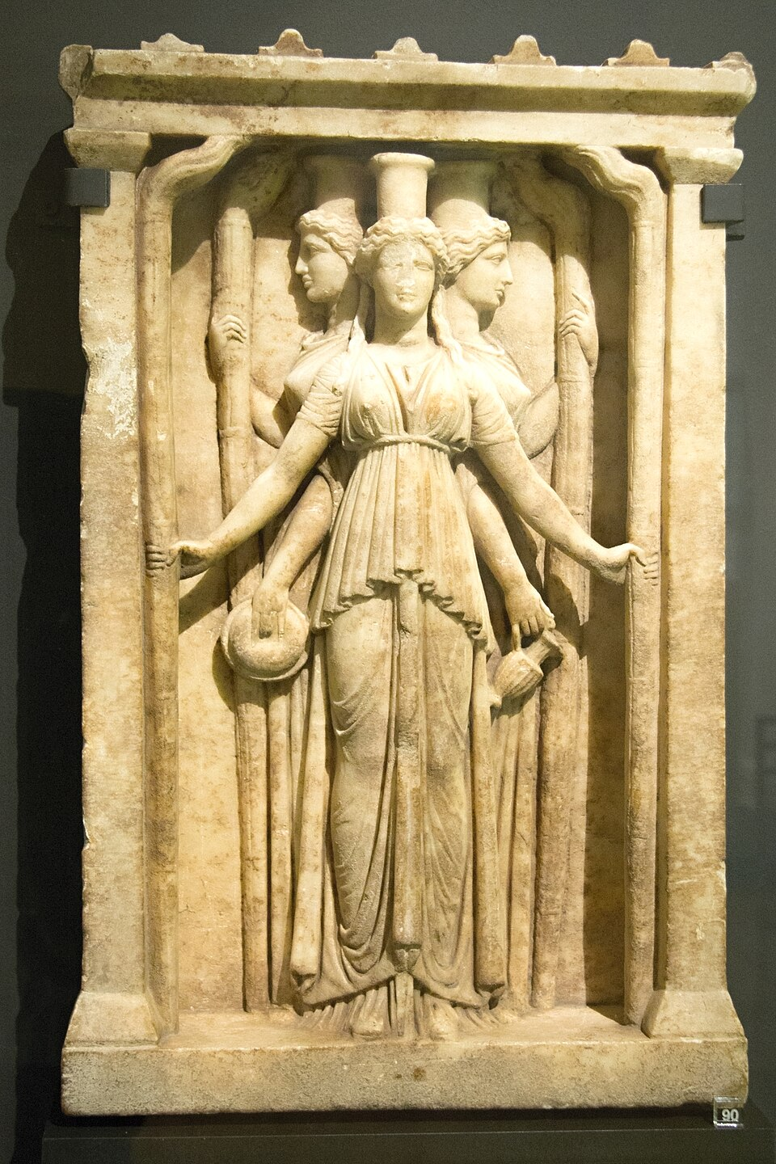




THE MYTH BEHIND THE RETELLING
Who was Hekate?
Hekate is a Titan, the generation of gods that were defeated by Zeus and the others.
In Greek myth, Hekate is the Titan goddess of magic, witchcraft, the crossroads, keys, ghosts and the moon. She is a liminal deity: she belongs to the in-between: doorways, borders, and the threshold between the living and the dead.
Magic
Crossroads
The Moon
Keys
Sorcery, Pharmaka (magic herbs), & Necromancy
Where paths & choices meet
Goddess of the night sky
Unlocks hidden ways
WORD TO KNOW liminal — relating to a boundary or threshold; a space that is neither one thing nor the other.
HEKATE · NIKITA GILL
3
Notes:
Front-load the mythology so students aren't lost. Key idea = LIMINAL : Hekate lives on thresholds and borders, which is exactly why she belongs to the Underworld in this story.
She was often pictured holding twin torches and keys, and sometimes shown three-faced, looking down every road at once. Quick check: ask students for other 'in-between' places (doorways, dusk, the coast).

Slide 5
THE WORLD SHE IS BORN INTO
A war among the gods
The Titanomachy — a ten-thousand-year war that splits the oldest family in the universe.
The Titans
The Olympians
VS
The old gods — the ancient, ruling generation.
The new gods, rising to seize their place.
The winners take the universe. The losers are imprisoned and tortured forever.
HEKATE · NIKITA GILL
4
Notes:
Keep it brief.
Emphasise that Hekate begins life with no safety: she is, in effect, a refugee of a war she didn't start.
CONTENT NOTE: the book engages with war, fear, loss and grief. The 'child of a war' framing can resonate strongly with students who have lived through conflict or displacement: pitch with care and openness.

Slide 6
THE SETTING
The Underworld
Much of the story unfolds below the living world. The deeper you go, the darker it gets.
The World Above
the realm of the living
The River Styx
the river that carries the dead across
The Asphodel Meadows
where most souls drift after death
The House of Hades
the dark palace that rules the Underworld
Tartarus
the deepest pit - prison of the defeated Titans
HEKATE · NIKITA GILL
5
Notes:
Orient students in the world before they read. The book even opens with a 'Map of the Realms of the Night'. Keep this as geography, not a story.
Useful framing question: is the Underworld a place of punishment, or could it be a place of refuge and home?

Slide 7

HOW THIS BOOK IS WRITTEN
A verse novel
What is a verse novel?
How to read it
A whole story told in poems, not prose paragraphs.
Written in first person: we're inside her head.
Image-rich and emotionally intense.
White space and line breaks carry meaning.
Looks sparse on the page, but hits hard.
Read passages aloud; it's written to be heard.
Read for feeling first, then for detail.
Notice where a line breaks and why.
Some chapters slip into prose – why do you think that is?
HEKATE · NIKITA GILL
6
Notes:
Most Year 9s won't have read a novel-in-verse.
Reassure them it reads FASTER than it looks.
Best move: read the opening pages aloud from your copy so they hear the rhythm before they read alone.
Ask them to notice one image and one line break that stood out.

Slide 8





DRAMATIS PERSONAE
Who you'll meet
A small cast of gods, monsters and ghosts: these are the figures to keep track of.
Hekate
Asteria & Perses
Nyx
Styx
Our heroine - goddess of magic & crossroads
Her parents – titans of falling stars & destruction
Night herself, one of the oldest goddesses
Goddess of the river of the dead
Hades
Charon
Cerberus
Thanatos
Ruler of the Underworld
The ferryman who rows the dead across the River Styx
The many-headed hound at the gate
The kind god of death
HEKATE · NIKITA GILL
7
Notes:
A quick 'who's who' so names don't trip them up.
Don't over-explain roles: keep it light and intriguing. Note that several of these (Styx, Hades, Charon, Cerberus) become the people Hekate lives among: a possible 'found family’.
You might ask students to predict which of these will be a friend and which a threat.
Remember, Hades is the god of the dead, and Thanatos is the god of death and dying

Slide 9
THE JOURNEY AHEAD
The shape of her story
The book is told in three parts — a journey from powerlessness to power.
I
II
III
A Child of War
The Realm of the Dead
A Woman of Power
Born into the losing side of the war between the gods and the Titans. Dropped in the underworld powerless and alone
Growing up in the dark, exploring the underworld, and finding out what she can do.
Becoming the goddess of magic
HEKATE · NIKITA GILL
8
Notes:
Show the arc without spoiling events - these are just the three part-titles.
This is a classic coming-of-age shape: from a powerless child to a woman who claims her own strength.
Ask: what do you think has to happen for someone to go from Part I to Part III?

Slide 10





WHAT IT'S REALLY ABOUT
Themes to watch for
Keep your eyes open for these as you read.
Power
Found family
Grief & love
Who is allowed to hold it and what it costs.
The people we're born to, and the ones we choose.
What effect does having and losing love have?
War & belonging
Becoming yourself
A woman's voice
Growing up in conflict and finding home.
Defining who you are against others' expectations.
An old story retold from her side, in her words.
HEKATE · NIKITA GILL
9
Notes:
Give students a 'lens' before reading
You could assign each table ONE theme to track and report back on.
Note 'found family' especially: the gods of the Underworld may become Hekate's chosen people.
'A woman's voice' links to the next slide on why we retell myths.

Slide 11
THE BIGGER IDEA
Why retell an old myth?
The old way
The retelling
Most Greek myths were written by men, long ago. Women in them were often prizes, victims, or monsters. They rarely tell their own story
This retelling hands the woman the pen. Same myth but from her point of view, with her fears, choices and inner life at the centre.
Discuss: whose stories get told and who gets to tell them?
HEKATE · NIKITA GILL
10
Notes:
This is the discussion springboard. Nikita Gill's whole body of work re-centres women in Greek and Hindu myth. Hekate sits alongside feminist retellings like Madeline Miller's Circe and Jennifer Saint's Ariadne.
Great talking points: which characters usually get to be the 'hero'? What changes when a 'monster' or 'witch' narrates her own life? Why might a poet choose Hekate specifically?

Slide 12
WHERE TO GO NEXT
If this world pulls you in…
New to Greek myth?
Loved the retelling?
Want more Hekate?
Percy Jackson
Circe
Book One of a trilogy
Rick Riordan — the friendliest way in
Madeline Miller
her story continues
Lore Olympus
The Song of Achilles
Gill's poetry
a hugely popular webcomic
Madeline Miller
Great Goddesses, Fierce Fairytales
Hades / Hades II
Ariadne / Elektra
Hindu stories too
award-winning video games
Jennifer Saint
Gill re-centres women across folklore
HEKATE · NIKITA GILL
11
Notes:
Two jobs here:
(1) give reluctant or myth-unfamiliar readers an easy on-ramp (Percy Jackson, Lore Olympus, the Hades games will hook a lot of them), and
(2) build a 'to-read' list for those who love it.
Mention that Hekate is the first book in a trilogy, so there's more to come.
Tailor recommendations to your class library where you can.

Slide 13

OVER TO YOU
Before you read
Discuss
Create
Do you think it will be a happy story or a sad one?
Will the Underworld be a place to fear - or a refuge?
Which character do you think you will like the most
Invent your own god or goddess.
Give them a name and a domain (what do they rule?). Design a symbol for them - like Hekate's key - and sketch it.
Keep these questions with you as we open the book.
HEKATE · NIKITA GILL
12
Notes:
Pre-reading engagement: predictions + a creative task that primes them for the book's ideas (domains, symbols, the power of naming).
Collect a few predictions on the board to revisit after reading
Then: open the book and read the prologue aloud together.

