Slide 1
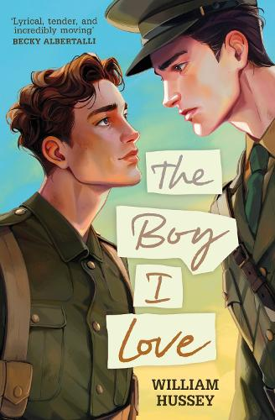
At just nineteen, Stephen has already survived a year at the front. Now he is returning to the trenches to lead a platoon, despite his wounds.
Broken-hearted from the loss of his first love, Stephen wonders what he's fighting for. Then he meets Private Danny McCormick, a smart, talented young recruit. From their first meeting, there's something undeniable between them – something forbidden by both society and the army.
Determined to protect Danny, Stephen must face down the prejudices and ignorance of his superiors as well as the onslaught of German shells and sniper fire. As the summer of 1916 ticks down to one big push on the Somme, can Stephen and Danny stay together – and will their love save them – or condemn them?

Slide 2
The story follows a clear emotional journey, set during World War I, and focuses on love, identity, and survival.
The story jumps between the past and present, helping us understand what Stephen has been through.
The novel opens with Stephen (aged 19) returning to the front after being wounded, haunted by the memory of a lost love and questioning what he’s fighting for.
Early chapters introduce Stephen’s past (his previous love, his trauma, his position in the army) and set up the context of the First World War.
The relationship between Stephen and Danny develops
under tension: external pressures from army hierarchy, prejudice, the dangers of war, suspicion from others.
Tensions increase as the Battle of the Somme approaches.
The push for the Battle of the Somme represents
the narrative high point: who survives, who dies, and the aftermath of this major battle for the soldiers.
The structure follows a classic arc, but what gives it strength is the tension between love and war, and how internal/invisible conflicts (identity, prejudice, guilt) mirror the external one (combat, authority).

Slide 3
Historical Context
The story is set in 1916, leading up to the Battle of the Somme, one of the deadliest battles in WWI, with massive casualties and little territorial gain. The British army took over 57,000 casualties on the first day alone with nearly 20,000 British soldiers dying, making it the bloodiest day in British military history.
Overall, over a 1 million soldiers from both allied and German sides died over the 4 months of the Battle of the Somme.
Trench warfare, gas, artillery bombardment, high mortality, poor conditions, shell shock…were realities soldiers faced. Soldiers lived in muddy trenches, faced explosions, and saw friends die every day.
Military Hierarchy, Discipline, and Prejudice
The British Army in WWI was rigidly hierarchical. Officers and non-commissioned officers had strict authority over men.
Being gay at that time was criminalised in Britain (it was illegal and stigmatized). Soldiers suspected of being gay faced severe consequences, ostracism, military trial, or imprisonment- no matter their rank in the army.
Society expected men to behave a certain way, in terms of masculinity and duty. Showing emotions apart from aggression, expressing love or fear wasn’t considered manly.
The war caused emotional scars
(what we now call PTSD was called Shell shock), but back then people didn’t understand it well.

Slide 4
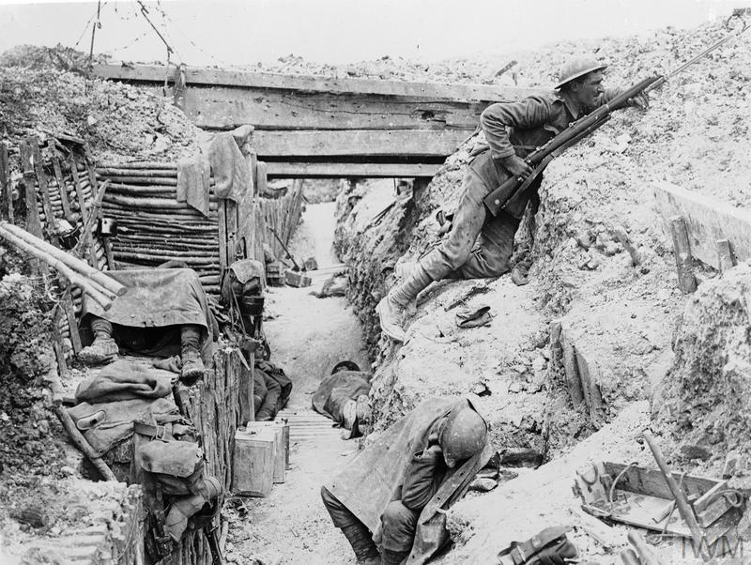
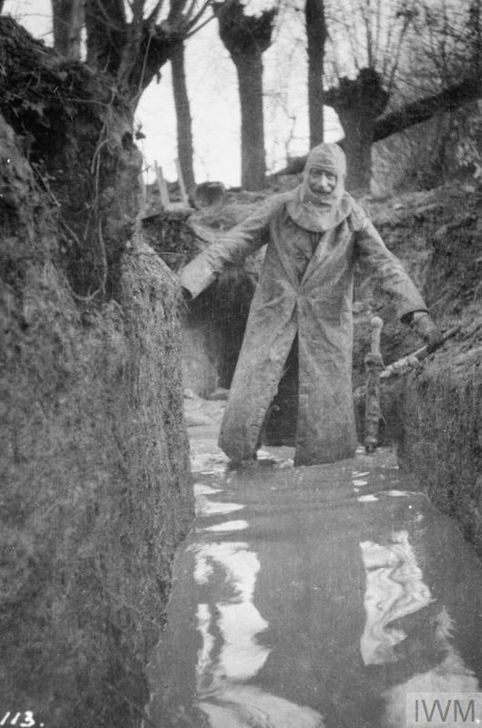
© IWM (Q 51569)
British soldiers occupy a captured German trench
at Ovillers-la-Boisselle on the Somme.
One man keeps sentry duty while his comrades rest.
WM (Q 3990)
10 Photos of Life in the Trenches During World War 1

Slide 5
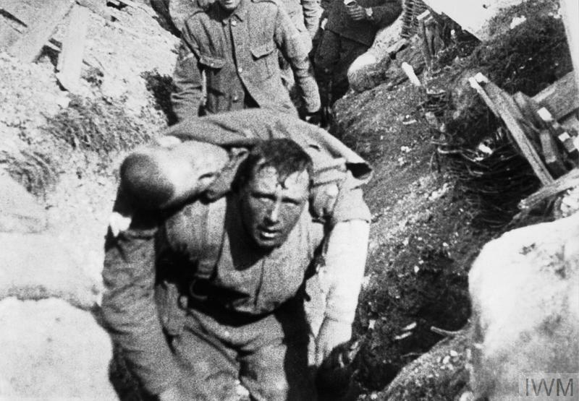
Still from the film "The Battle of the Somme" showing a British soldier carrying a wounded comrade back from the front line.
The scene is generally accepted as having been filmed on the first day of the battle, 1 July 1916.
Image: IWM (Q 79501)

Slide 6
Discussion prompts:
- What feelings did you have while reading this book?
- How does the author show that Stephen is struggling with trauma?
- What do you think makes Stephen a strong or brave character?
- How does war make it harder for people to be themselves?
- What do Stephen and Danny teach us about hope?
- Do you think this story is still important today? Why or why not?

Slide 7
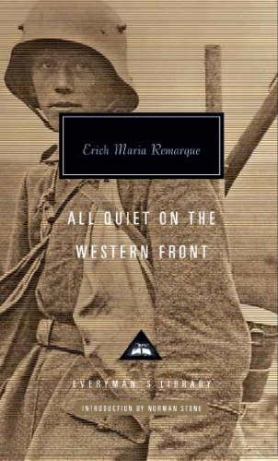
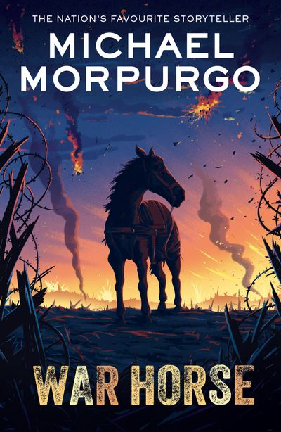

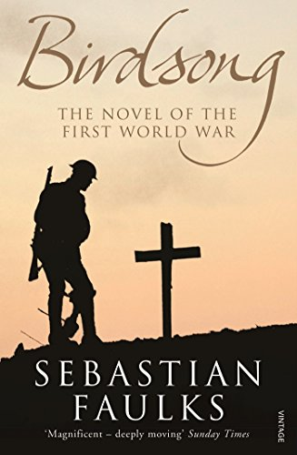
MUST READS!
A few years after it was published in 1929 the Nazis would denounce and burn this book for insulting the heroic German army - in other words, for 'telling it like it was' for the common soldier on the front line where any notions of glory and national destiny were soon blasted away by the dehumanizing horror of modern warfare.
Remarque has an extraordinary power of describing fear: the appalling tension of being holed up in a dugout under heavy bombardment; the animal instinct to kill or be killed which takes over during hand-to-hand combat. He also has an eye for the grimly comic: the young soldiers joyfully tucking into double rations when half their company are unexpectedly wiped out.
All Quiet on the Western Front
Products Archive - Michael Morpurgo
One of the greatest war novels in the English language, Faulks' profoundly moving masterpiece of love, death and redemption plays out in both pre-war Amiens and the trenches of the Western Front.
A classic novel that provides a realistic and harrowing look at the experiences of German soldiers on the Western Front

Slide 8
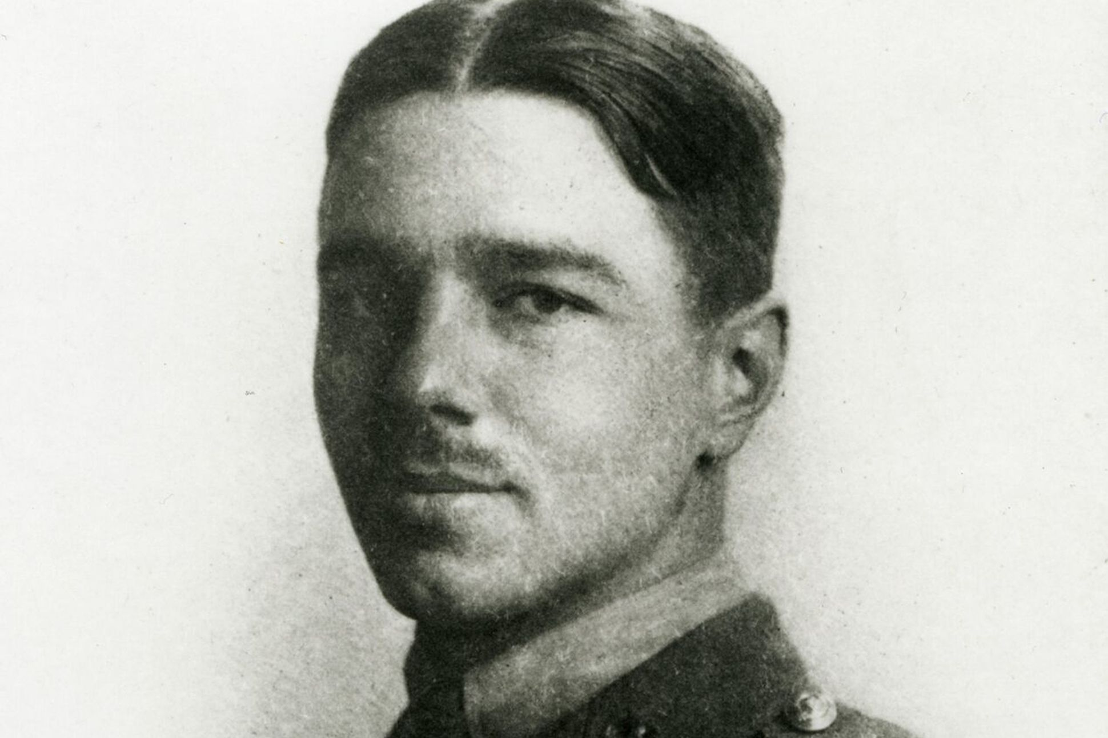
Dulce et Decorum Est By Wilfred Owen, 1917
Bent double, like old beggars under sacks,
Knock-kneed, coughing like hags, we cursed through sludge,
Till on the haunting flares we turned our backs
And towards our distant rest began to trudge.
Men marched asleep. Many had lost their boots
But limped on, blood-shod. All went lame; all blind;
Drunk with fatigue; deaf even to the hoots
Of tired, outstripped Five-Nines that dropped behind.
Gas! Gas! Quick, boys! – An ecstasy of fumbling,
Fitting the clumsy helmets just in time;
But someone still was yelling out and stumbling
And flound’ring like a man in fire or lime. –
Dim, through the misty panes and thick green light,
As under a green sea, I saw him drowning.
In all my dreams, before my helpless sight,
He plunges at me, guttering, choking, drowning.
If in some smothering dreams you too could pace
Behind the wagon that we flung him in,
And watch the white eyes writhing in his face,
His hanging face, like a devil’s sick of sin;
If you could hear, at every jolt, the blood
Come gargling from the froth-corrupted lungs,
Obscene as cancer, bitter as the cud
Of vile, incurable sores on innocent tongues, –
My friend, you would not tell with such high zest
To children ardent for some desperate glory,
The old Lie: Dulce et decorum est
Pro patria mori
Wilfred Owen, who wrote some of the best British poetry on World War I, composed nearly all of his poems in slightly over a year, from August 1917 to September 1918.
He was a close friend of Siegfried Sassoon.
In November 1918 he was killed in action at the age of 25, one week before the Armistice.
Wilfred Owen | The Poetry Foundation

Slide 9
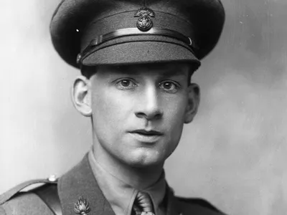
In 1914 Sassoon enlisted and was twice seriously wounded while serving as an officer in the British Army in France. His extreme bravery earned him the Military Cross, and he was appointed a Commander of the Order of the British Empire. He was given an honorary degree from Oxford University for his literary work and the Queen’s Medal for Poetry.
Although Sassoon’s poems brought him fame, some critics regarded his work as being violent, and unpatriotic. He was a vocal anti-war protester. He was also gay but could not live openly as one due to the legal consequences.
Siegfried Sassoon | Biography, Poems, Books, & Death | Britannica
The General
By Siegfried Sassoon
“Good-morning, good-morning!” the General said
When we met him last week on our way to the line.
Now the soldiers he smiled at are most of 'em dead,
And we're cursing his staff for incompetent swine.
“He's a cheery old card,” grunted Harry to Jack As they slogged up to Arras with rifle and pack.
But he did for them both by his plan of attack.
“I believe that the War is being deliberately prolonged by those who have the power to end it.”
The letter published in The Times was read out in the House of Commons and Sassoon narrowly avoided a court-martial.
He was interned in a sanatorium where he met and influenced another pacifist soldier-poet Wilfred Owen, whose works he published after Owen was killed at the front.

Slide 10

‘It has been an epic three-year journey to bring this heart-rending wartime love story to readers. Realising the world of Stephen and Danny has been a labour of love, from years of meticulous research to crafting the central relationship and bringing to life the camaraderie, passion and horror of a romance flowering in the shadow of the Battle of the Somme. All I can say is – get ready to have your heart broken and then mended by a story inspired by the lives of real gay soldiers who served and sacrificed everything’ The Boy I Love by William Hussey, new book coming January 2025 - Andersen Press
William Hussey | 'As a gay author I know how books can change queer lives' #queervoices #lgbtq
There is a long tradition of war literature (e.g. All Quiet on the Western Front, Birdsong) that grapple with duty, sacrifice, trauma, disillusionment. However, LGBTQ+ perspectives in war literature are far less common, because their history was suppressed (many soldiers didn’t have their stories told; diaries destroyed, letters censored or self-censored due to fear of legal consequences).

Slide 11
SOURCES
Imperial War Museum sources:
- Key Facts about the Battle of the Somme | Imperial War Museums
- 10 Photos of Life in the Trenches During World War 1
- Imperial War Museum: Trench warfare explained: https://youtu.be/9E7xYLv8N2E
Wilfrid Owen: Wilfred Owen | The Poetry Foundation
Siegfried Sassoon: Siegfried Sassoon | Biography, Poems, Books, & Death | Britannica and Siegfried Sassoon | The Poetry Foundation
KS3 / KS4 / GCSE History: WW1 poetry, shell shock and Siegfried Sassoon - BBC Teach
BBC Radio 4 - In Our Time, Siegfried Sassoon
From William Hussey:
The Boy I Love by William Hussey, new book coming January 2025 - Andersen Press
William Hussey | 'As a gay author I know how books can change queer lives' #queervoices #lgbtq

